Slide 1
XAR
Chest X-ray diagnosis and analysis, Now just a click away.

Slide 2
Group Members
Maryum Hamid
Maham Mukaram
Muskaan Khattak
Zohaa Abid
Supervisor
Dr. Muhammad Usman Akram
Lecturer Ali Saeed
Miss Anam Abdus salam
Industrial Partner
RiseTech

Slide 3
Presentation Outline
Group member contribution
Problem statement
Introduction
Relevant work
Proposed and implemented methodologies:
1. Data collection
2. Data preprocessing
3. Report generation (image captioning)
4. Disease classification
5. Segmentation
6. Heap map
7. User Interface
Future Works
References
[1]

Slide 4
Group Member Contribution
Zohaa Abid
Data collection
Data Cleaning
Data preprocessing
Data Augmentation
Maham Mukaram
Disease Classification
Image Captioning
Report Generation
Maryum Hamid
Disease Segmentation
Heap map generation
Disease Classification
Muskaan Khattak
Database creation
Model integration
Web application
Cloud deployment

Slide 5
Problem Statement
To develop a cloud based intelligent platform, using deep learning and image processing algorithms, for analysis of chest x-ray, to generate a detailed report on thoracic diseases, used as a pre-diagnosis to lower possibility of misdiagnosis and ensure treatment before fatality.

Slide 6
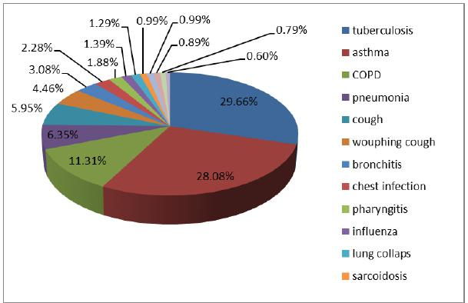
INTRODUCTION
Lung diseases common cause of death in Pakistan
Due to Covid-19 → spike in lung disease patients
Early diagnosis means early treatment
Early treatment → less chance of fatality
5% misdiagnosis
Doctors need to give priority in Covid19 days
Less influx into hospitals

Slide 7
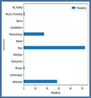
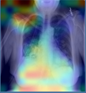
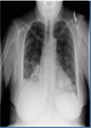
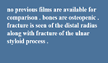
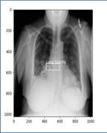
GENERAL FLOW CHART
IMAGE PRE-PROCESSING
Histogram Equalization and Image augmentation for better classification accuracy
DISEASE CLASSIFICATION
Using Effecientnet B4 based model trained to classify 12 diseases fine-tuned on CXR14 dataset
HEAT MAP GENERATION
GradCAM based on effecientnet model.
UPLOAD IMAGE
Can be in an format (.jpg, .png, etc.)
REPORT GENERATION
Using encoder decoder based model trained on local dataset.
Web-application
Front end development on Flask: Sign-up, Login, Homepage Report generation page etc.
Deployment on Cloud
using Microsoft Azure
Database development
Using Azure Database
IMAGE PRE-PROCESSING
Histogram Equalization, Image Augmentation, etc. for better segmentation results
SEGMENTATION
Using Yolo v4 to detect Lung Opacity.

Slide 8
DATA SETS

Slide 9
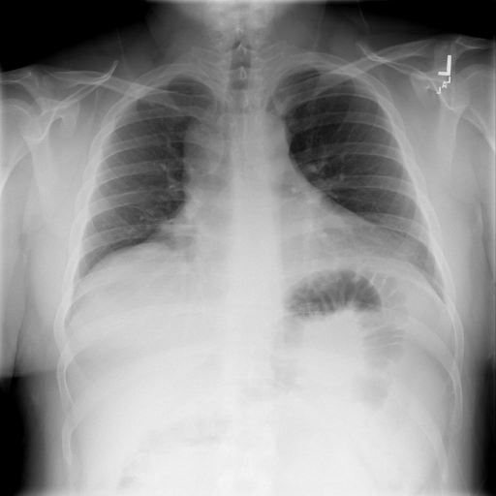
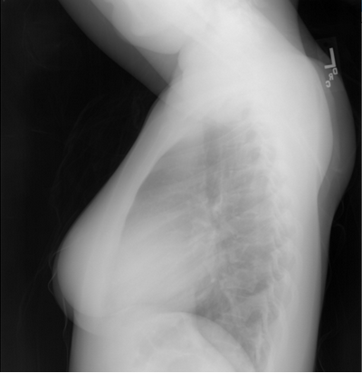
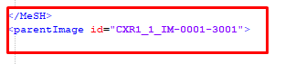
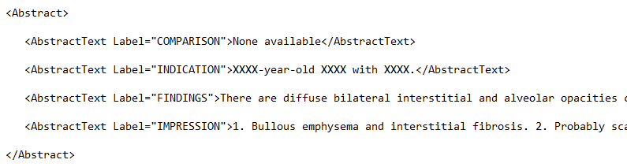
INDIANA DATASET [1]
7470 images
3955 reports
For Report Generation

Slide 10
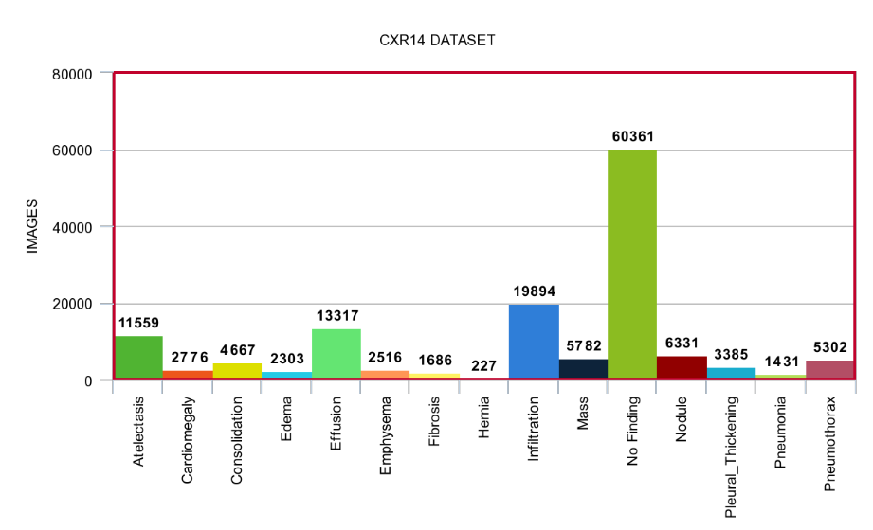
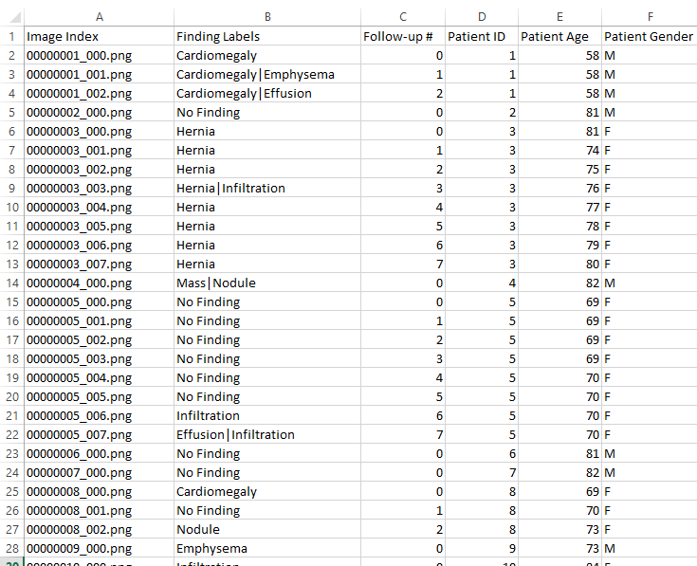
CXR14 DATASET [2]
112120 images
14 diseases
Stored collectively
For Classification
PREPROCESSING: Separated Images into
separate disease folders

Slide 11
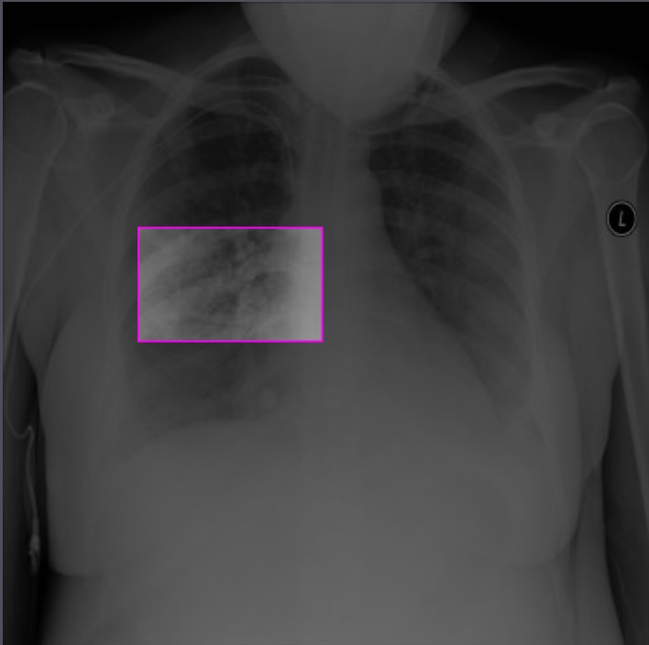
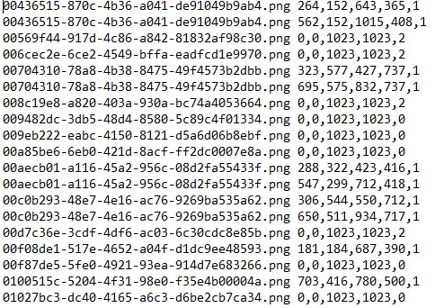
8500+ images for lung opacity with corresponding bounding box coordinates. 10000+ images which indicate no lung opacity.
DATA SET USED IN YOLO V4 FOR SEGMENTATION [3]

Slide 12
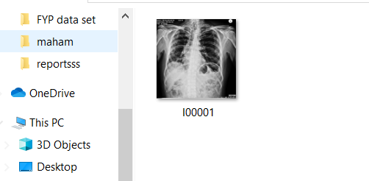
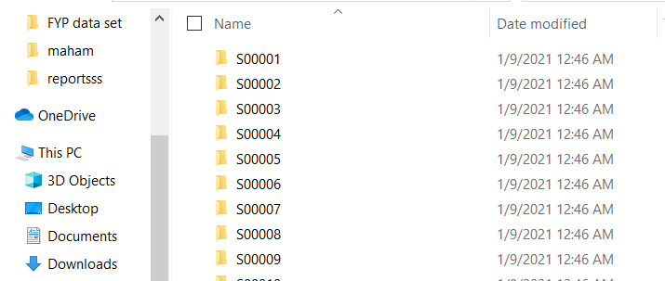
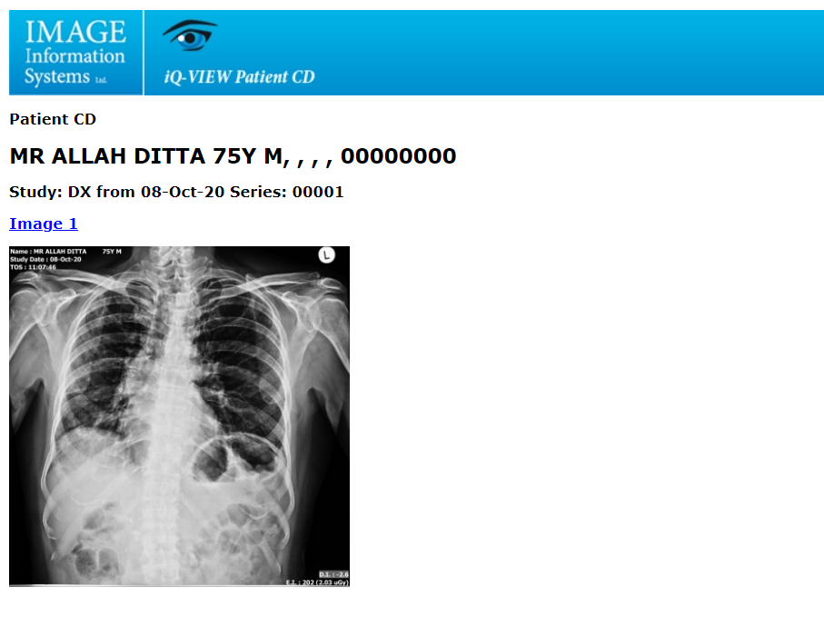
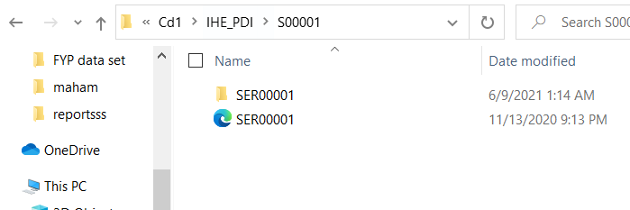
LOCAL DATA SET
Initially the data given was in raw and scattered form.

Slide 13
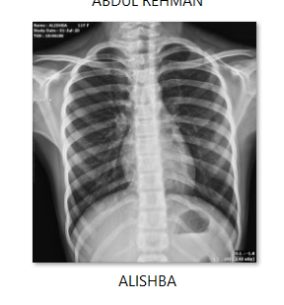
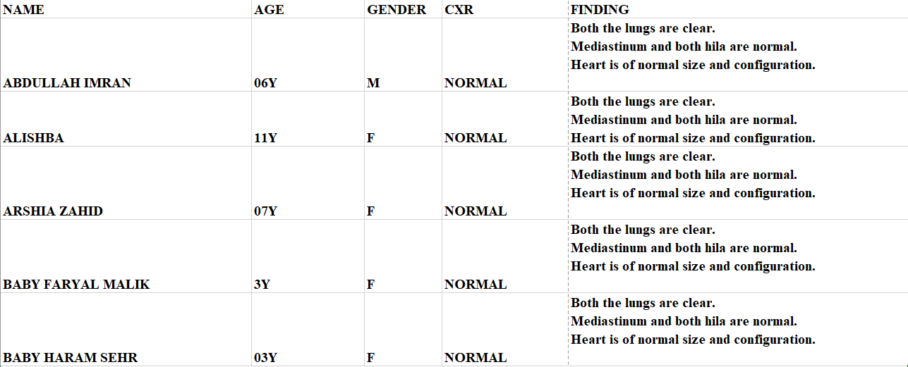
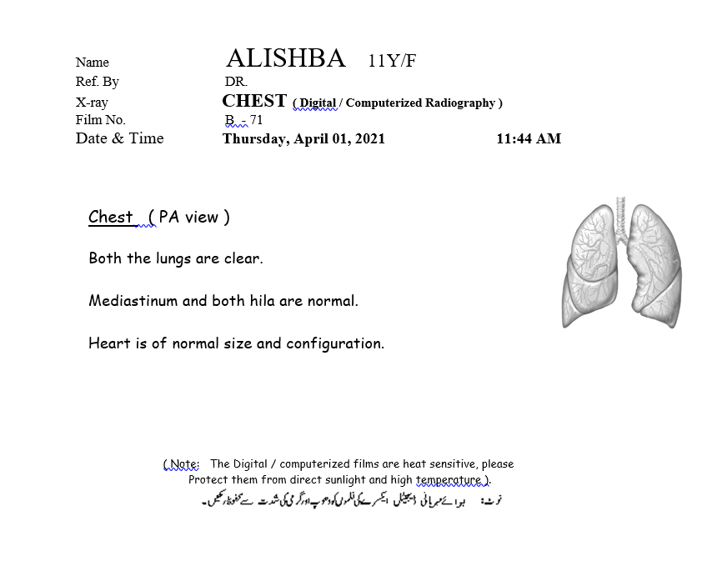
LOCAL DATASET
X-RAY IMAGE
CSV FILE
REPORT

Slide 14
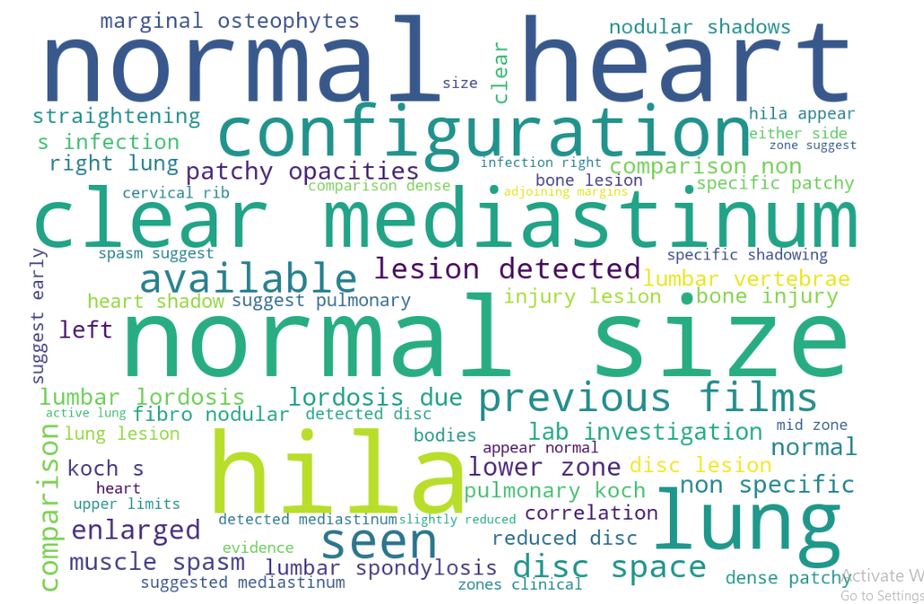
REPORT GENERATION: PREPROCESSING
UNIQUE WORDS: 543
UNIQUE CAPTIONS: 238
PATIENT REPORTS: 15,970
PATIENT IMAGES: 2345
PATIENTS WITH BOTH IMAGES AND REPORTS: 2338
Train and test data split: most of the captions with lower frequency were kept in training dataset.
Augmentation method (in training dataset): Sampling
captions>50 → down sampled by 2
captions<=5 → up sampled by 10

Slide 15
MODELS

Slide 16
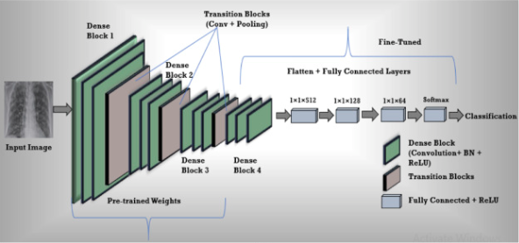
REPORT GENERATION: ENCODER MODEL
The encoder extracts key features from the image using a convolutional neural network (in our case ChexNet)
ChexNet is a 121-layer convolutional neural network, consisting of Dense blocks, trained on CXR 14.
Dense layer having 512 neurons
Output as key features fed into decoder
Dropout Rate = 0.2
(244,244,3)
(9,1024)
DENSE LAYER
(9,512)
BATCH NORMALIZATION LAYER
(9,512)
DROPOUT LAYER
(9,512)
OUTPUT

Slide 17
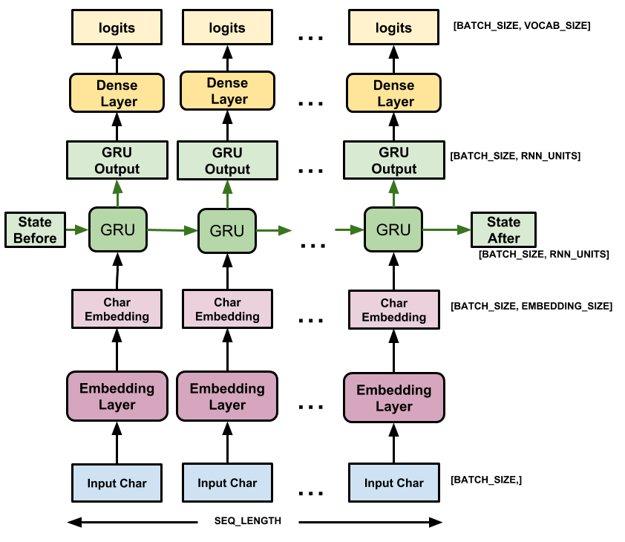
REPORT GENERATION: DECODER MODEL
Tokenization→ Each caption line edited as ‘<csv>+text+<end> and tokenizer fitted onto captions.
One Step Decoder: Caption fed as single character token.
Attention Mechanism
implemented
Recurrent Neural Network used
to generate the appropriate
Medical Report → GRU
Teacher Forcing Method: next original token passed
Concatenation Layer
Attention Layer
ENCODER OUTPUT

Slide 18
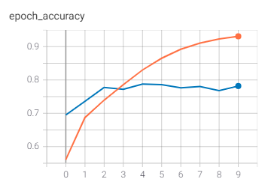
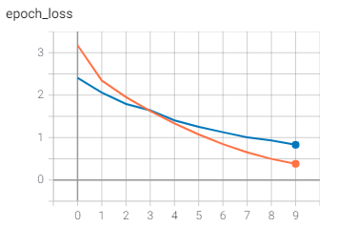
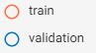
REPORT GENERATION: TRAINING AND RESULT
EPOCHS: 10
BATCH SIZE: 32
15 minutes per epoch (cpu)
 | BLEU 1 | BLEU 2 | BLEU 3 | BLEU 4
ATTENTION MECHANISM | 0.6054 | 0.4906 | 0.4258 | 0.3683

Slide 19
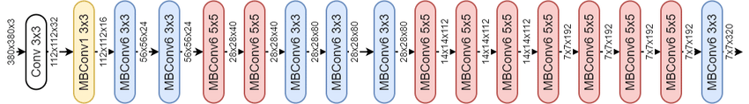
IMAGE CLASSIFICATION : EFFICIENTET B4
813 layers (majorly convolutional layers)
B4: accuracy and size
Fine tuned to chest x-rays

Slide 20
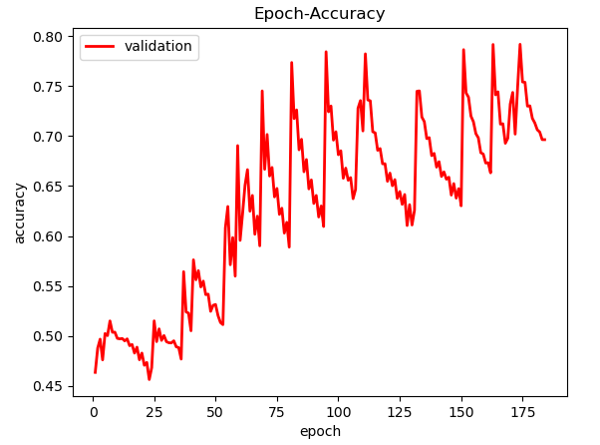
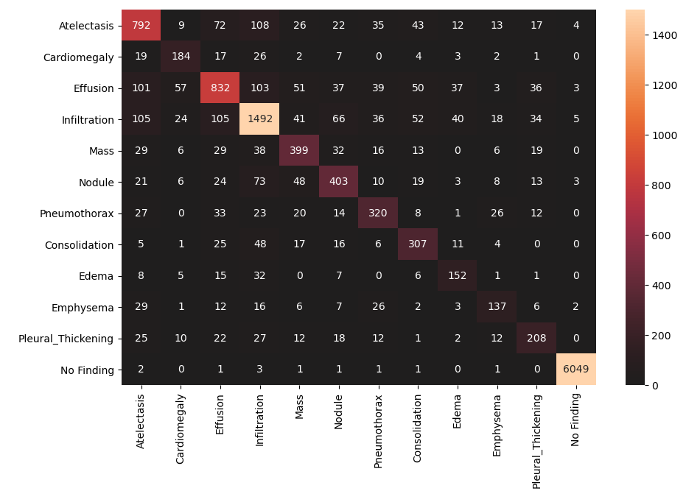
IMAGE CLASSIFICATION : TRAINING
Epochs: 200
Batch size: 2,3,5
Time per Epoch: 3-4 hours
Callbacks highlighted

Slide 21
IMAGE CLASSIFICATION : RESULTS
Disease | Number Of Images | Correctly Predicted | Precision | Recall | Accuracy | F1 Score
Atelectasis | 1153 | 792 | 0.68099 | 0.68690 | 0.946994 | 0.683937
Cardiomegaly | 265 | 184 | 0.60726 | 0.69433 | 0.985517 | 0.647887
Effusion | 1349 | 832 | 0.70092 | 0.61675 | 0.936857 | 0.656151
Infiltration | 2018 | 1492 | 0.75012 | 0.73934 | 0.925923 | 0.744696
Mass | 587 | 399 | 0.64044 | 0.67972 | 0.970166 | 0.659504
Nodule | 631 | 403 | 0.63968 | 0.63866 | 0.967052 | 0.639175
Pneumothorax | 484 | 320 | 0.63872 | 0.66115 | 0.975018 | 0.649746
Consolidation | 440 | 307 | 0.60671 | 0.69772 | 0.975959 | 0.649048
Edema | 227 | 152 | 0.57575 | 0.66960 | 0.986459 | 0.619144
Emphysema | 247 | 137 | 0.59307 | 0.55465 | 0.985228 | 0.573221
Pleural Thickening | 349 | 208 | 0.59942 | 0.59598 | 0.979724 | 0.597701
No Finding | 6060 | 6049 | 0.99719 | 0.99818 | 0.997972 | 0.997690

Slide 22
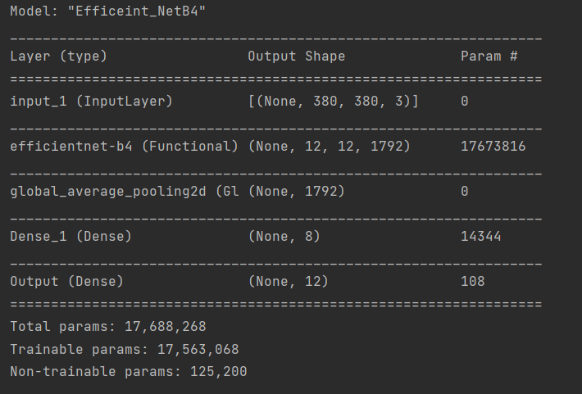
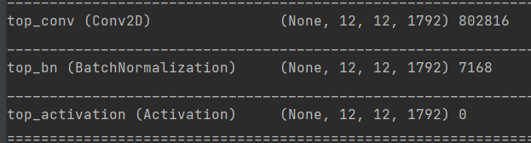
IMAGE SEGMENTATION: GRADIENT CLASS ACTIVATION MAPS
The predicted class weights
Last convolutional layer
Combining these gradient
Relu layer
Notes:
We have the gradient of a loss with respect to classification i.e. gradients with respect to all of the feature maps
We combine these gradient to become weights for each of the feature maps
Relu layer is applied on weighted combination of the saliency map in order to only show he positive correlations on the saliency map.

Slide 23
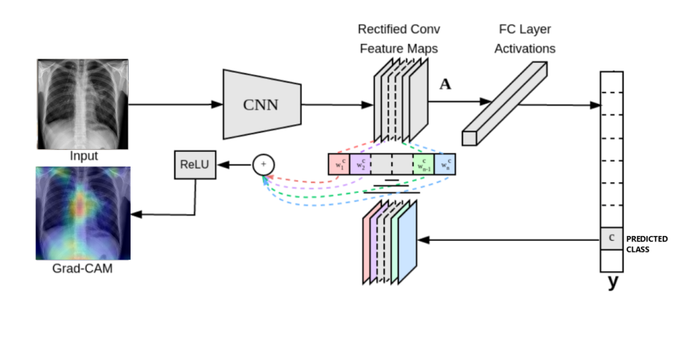

Slide 24
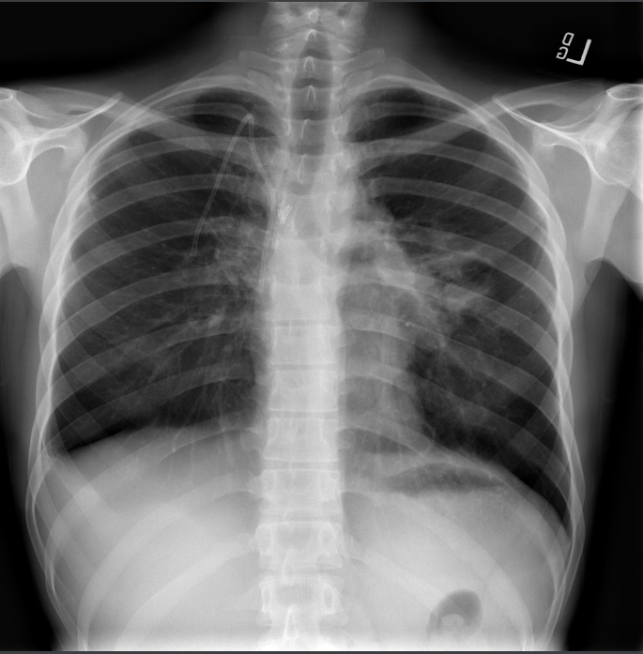
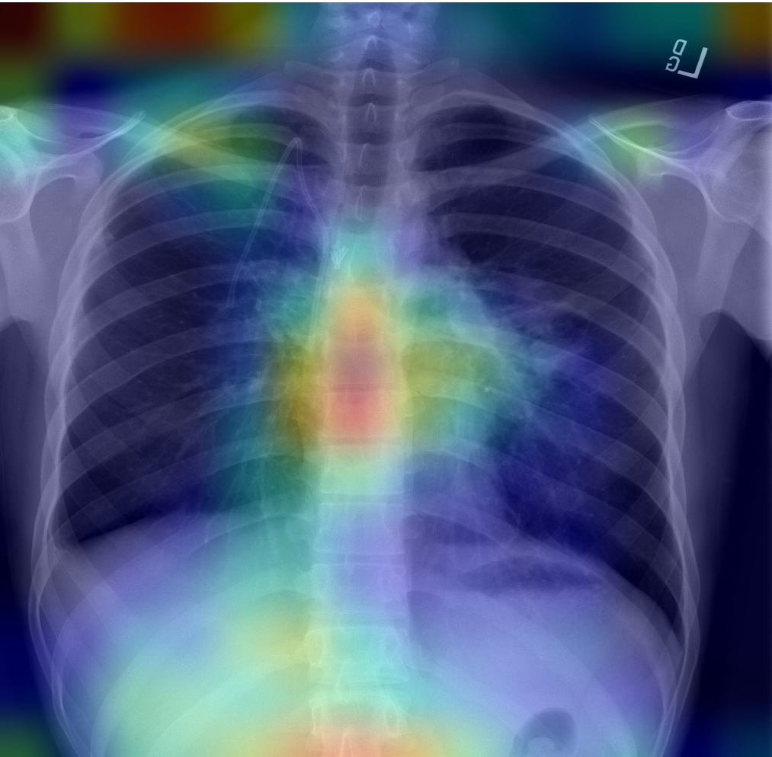
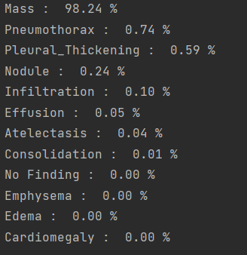
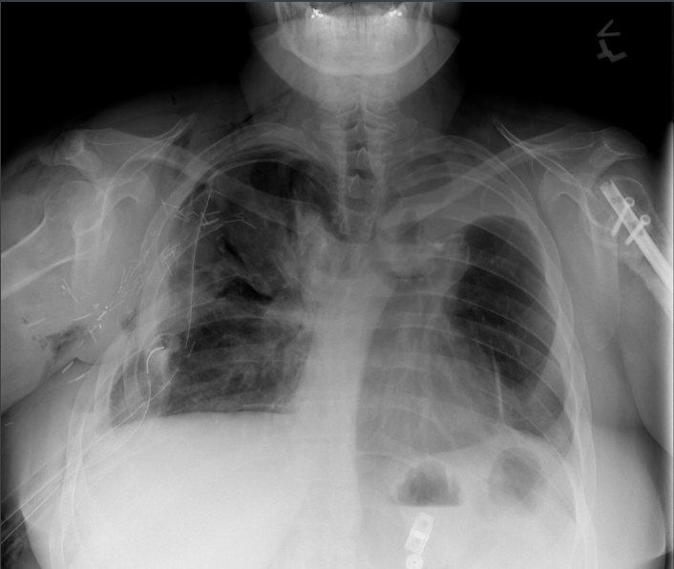
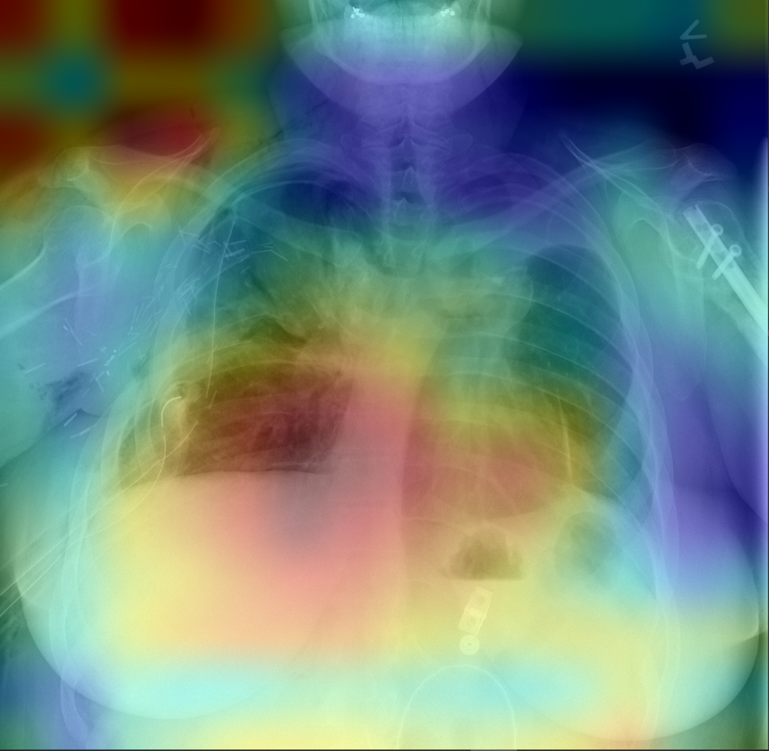
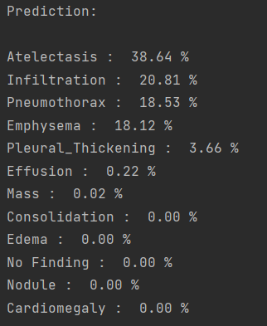
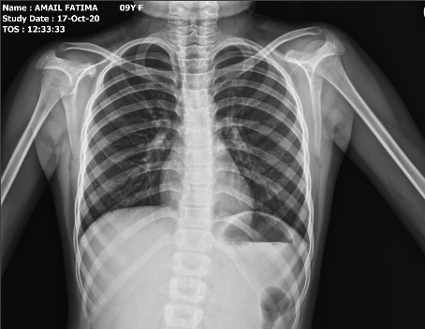
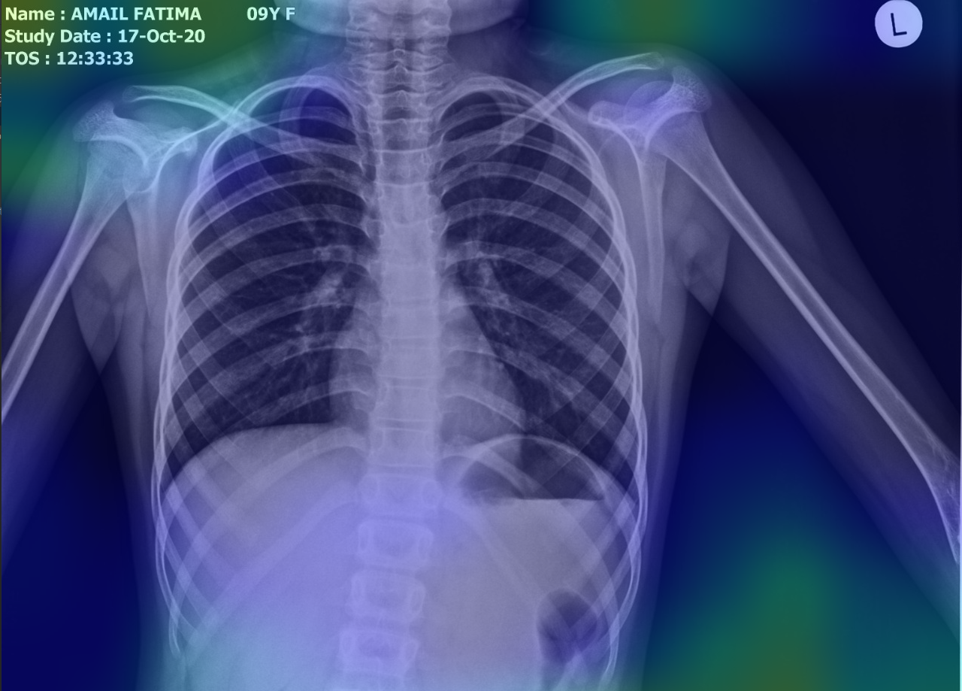
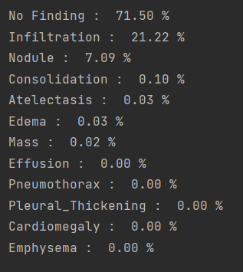

Slide 25
IMAGE SEGMENTATION: LUNG OPACITY DETECTION
Pulmonary opacification represents the result of a decrease in the ratio of gas to soft tissue (blood, lung parenchyma and stroma) in the lung

Slide 26
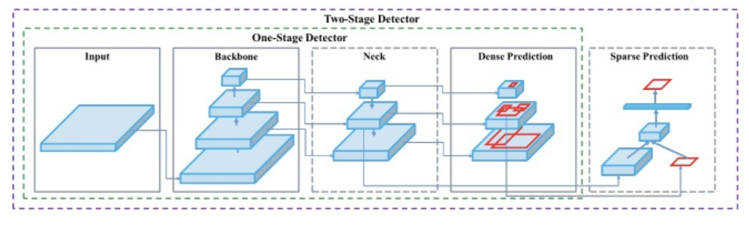
IMAGE SEGMENTATION: LUNG OPACITY DETECTION
YOLO V4
Notes:
Backbones for the YOLOv4 object detector:
CSPDarknet53

Slide 27
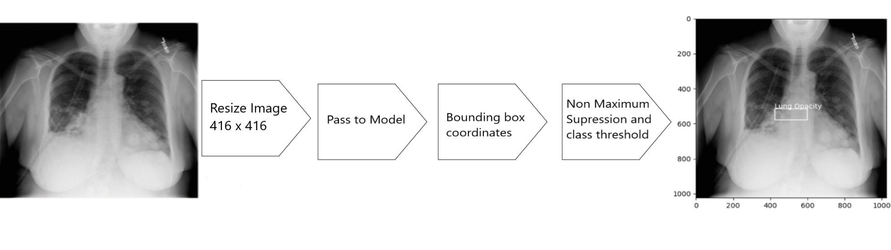
TRAINING
Input image (416,416) (RGB) IOU threshold → 0.5
Confidence Score → 0.3 30 minutes per epoch (GPU)
EPOCHS: 300 Class threshold: 0.60
BATCH SIZE: 2-5 Non Maximum Suppression

Slide 28
CLOUD BASED APPLICATION

Slide 29
Application development and deployment
The application is designed using flask
For model integration and logic development python was used
For frontend development html, CSS and JavaScript were used
Microsoft Azure and docker Hub was used to deploy the application on cloud.
Public cloud
Services used are Database as a service and Platform as a service(Paas)

Slide 30
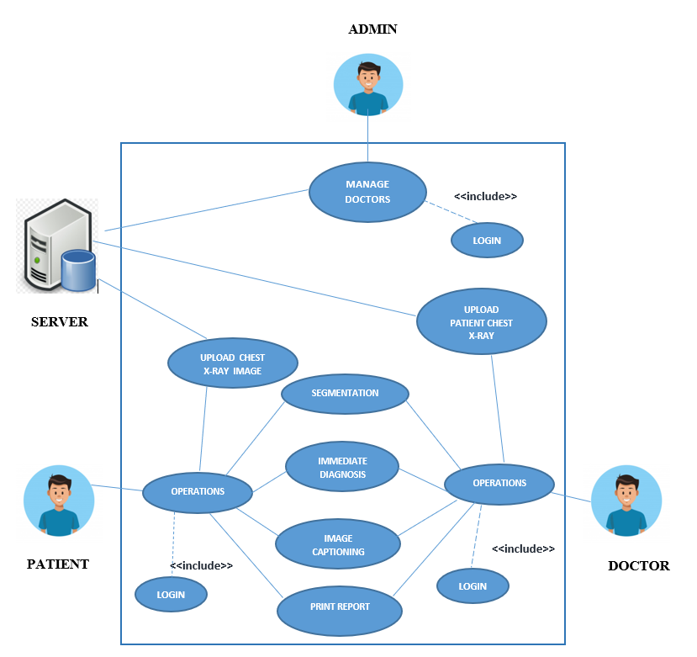
USE CASE MODEL

Slide 31
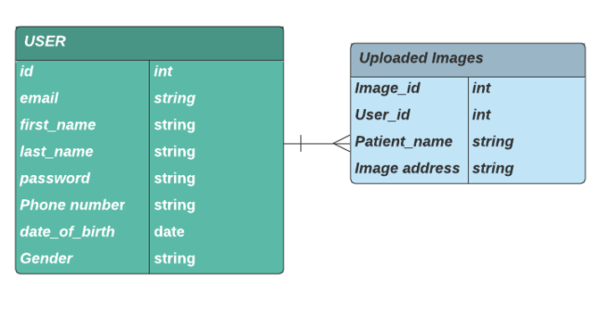

ENTITY REALATION DIAGRAM

Slide 32
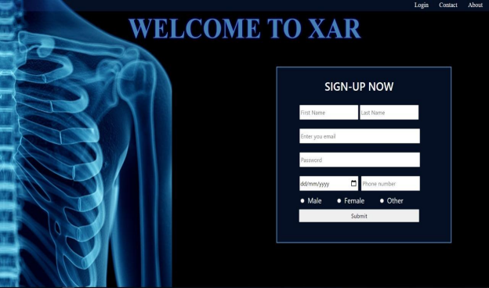
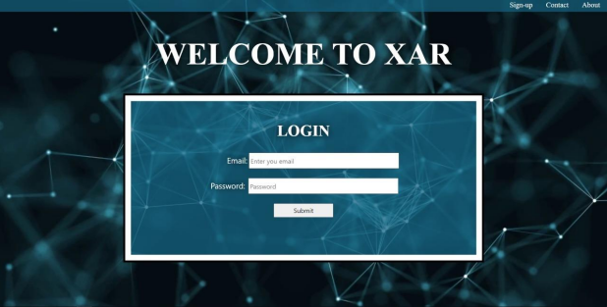
User Registration and Authentication
SIGN-UP PAGE
LOGIN PAGE

Slide 33
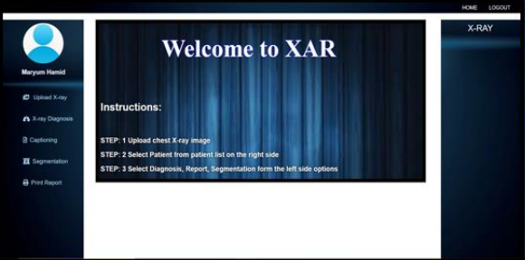
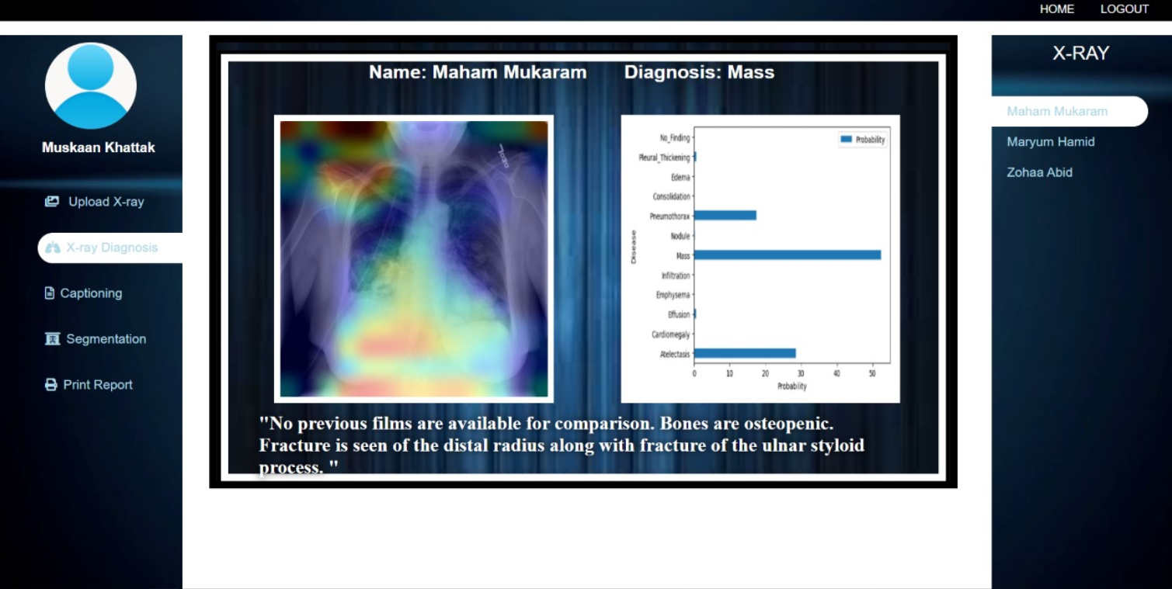


INTERFACE
Main Page
Diagnosis
Upload X-ray
Captioning

Slide 34



INTERFACE
Segmentation
Admin Interface
Print Report

Slide 35
DELIVERABLES AND KPIs
Cloud based application
Efficient algorithm
Validation from local hospital
Interfacing of web application with developed algorithm
Real-time processing

Slide 36
REFERENCES
https://www.kaggle.com/nih-chest-xrays/data
https://www.scielo.br/scielo.php?script=sci_arttext&pid=S1516-89132017000100418&lng=en&tlng=en
https://www.kaggle.com/c/rsna-pneumonia-detection-challenge/overview

Slide 37
THANK YOU

Slide 38
REPORT GENERATION: EMBEDDING LAYER
Single tokenized character of caption passed through embedding layer.
Pre-trained Glove vectors (300 dimensions) used as the initial weights for the layer
Used to differentiate between words e.g. bank
Each word represented by vector of size 300.

Slide 39


REPORT GENERATION: ATTENTION MECHANISM
Attention mechanism helps focus on the part of the image which is of our Region of interest.
We chose to concatenate for
better accuracy

Slide 40


REPORT GENERATION: GATED RECURRENT UNIT (GRU)
It predicts each word of the sentence after seeing the image vector, previous word and the Context vector
Two Gates:
Update Gate
Reset Gate

